Slide 1
SEQUENTIAL CIRCUIT
Flip Flops

Slide 2
GATED D LATCH
Gated D latch is called Transparent Latch.

Slide 3
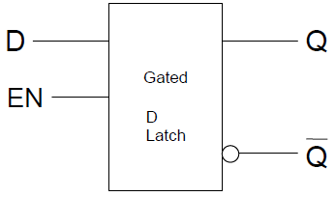
GATED D LATCH

Slide 4
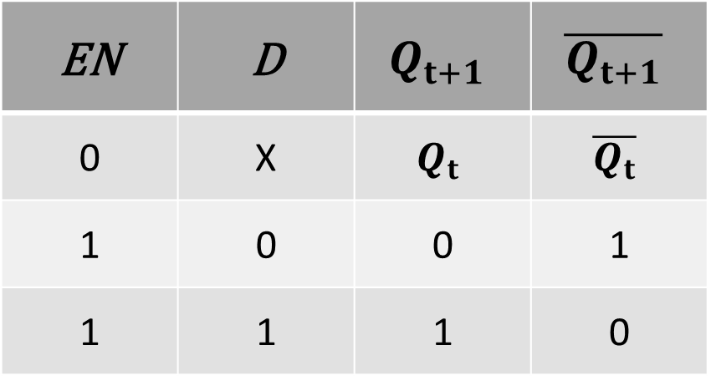
GATED D LATCH TABLE
EN | D | $$Q_{t+1}$$ | $$\overline{Q_{t+1}}$$
0 | X | $$Q_{t}$$ | $$\overline{Q_{t}}$$
1 | 0 | 0 | 1
1 | 1 | 1 | 0

Slide 5
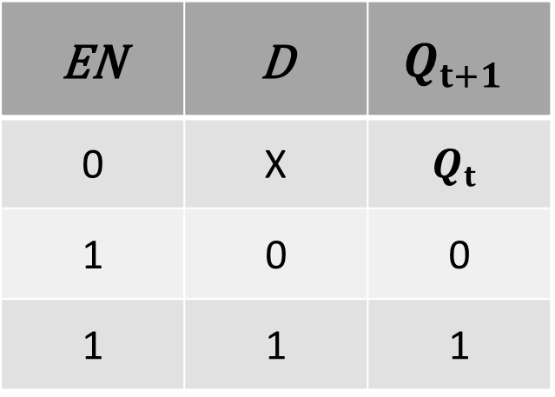
GATED D LATCH TABLE SUMMARY
EN | D | $$Q_{t+1}$$
0 | X | $$Q_{t}$$
1 | 0 | 0
1 | 1 | 1

Slide 6
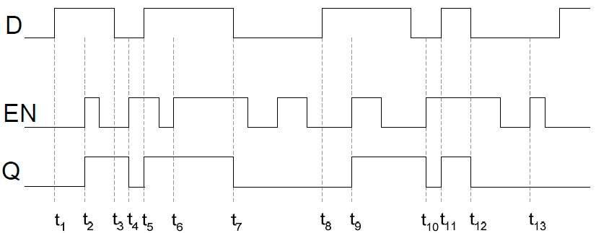
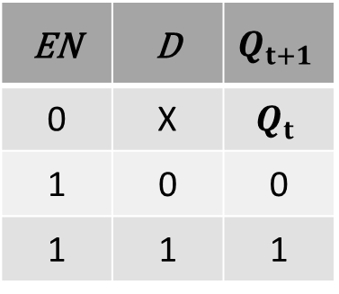
TIMING DIAGRAM D LATCH
EN | D | $$Q_{t+1}$$
0 | X | $$Q_{t}$$
1 | 0 | 0
1 | 1 | 1

Slide 7
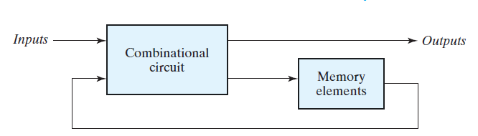
SEQUENTIAL CIRCUIT
Sequential circuit is a combination circuit with memory
Sequential circuit is specified by a time sequence of inputs, outputs, and internal states

Slide 8
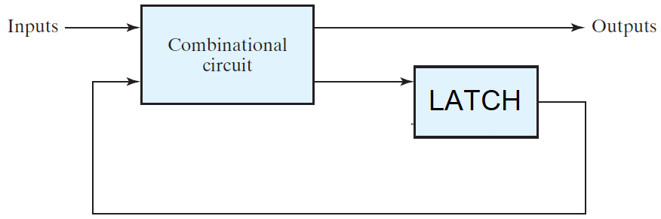
SEQUENTIAL CIRCUIT

Slide 9
TRIGGER
The state of a latch or flip-flop is switched by a change in the control input. This momentary change is called a trigger

Slide 10


CLOCK
Positive Clock Level
Positive Clock Edge
Negative Clock Edge

Slide 11
FLIP FLOP
The latch with pulses in its control input is essentially a FLIP-FLOP
FLIP-FLOP is triggered every time the pulse goes to the logic-1 level

Slide 12
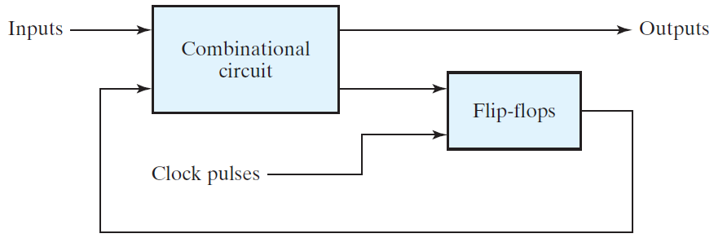
SEQUENTIAL CIRCUIT

Slide 13
Edge Triggered D FLIP FLOP
Master Slave FLIP-FLOP
Positive Edge Triggered FLIP-FLOP

Slide 14
CLOCK
Positive Clock Level
Negative Clock Edge

Slide 15
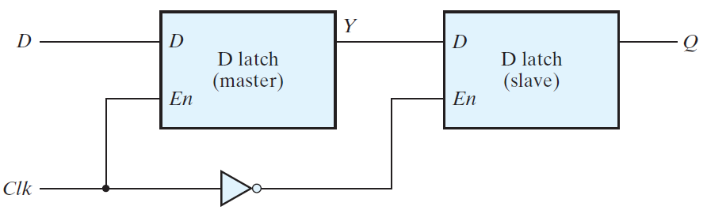
Master Slave D-FLIP-FLOP(NEGATIVE EDGE TRIGGERED)

Slide 16
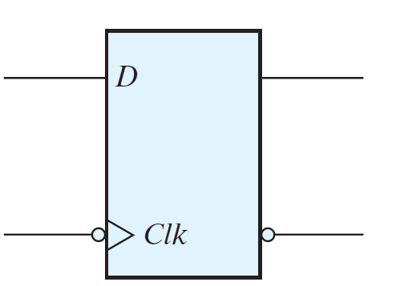
D-FLIP-FLOP (NEGATIVE EDGE TRIGGERED)

Slide 17


Master Slave FLIP-FLOP
MASTER |  |  | SLAVE
CLK | D | $$Y_{T+1}$$ | $$\overline{CLK }$$ | $$Y_{T+1}$$ | $$Q_{T+1}$$
$$\overline{CLK }$$

Slide 18
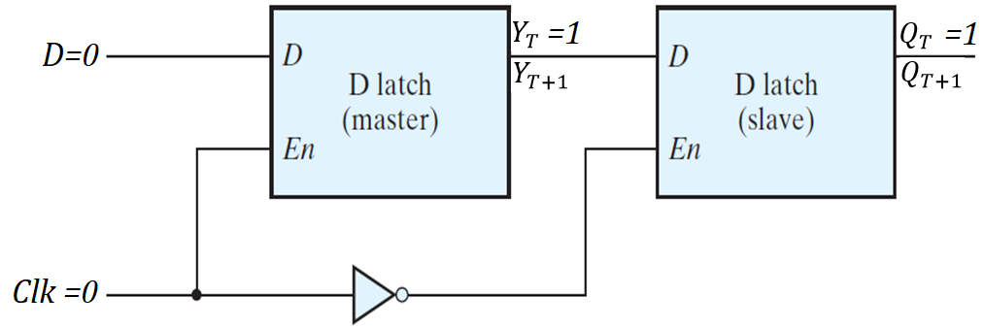

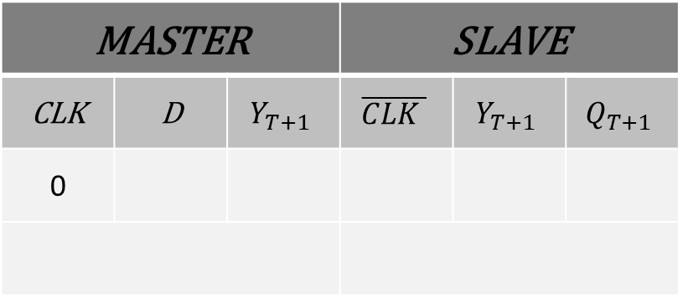
Master Slave FLIP-FLOP
MASTER |  |  | SLAVE
CLK | D | $$Y_{T+1}$$ | $$\overline{CLK }$$ | $$Y_{T+1}$$ | $$Q_{T+1}$$
0

Slide 19
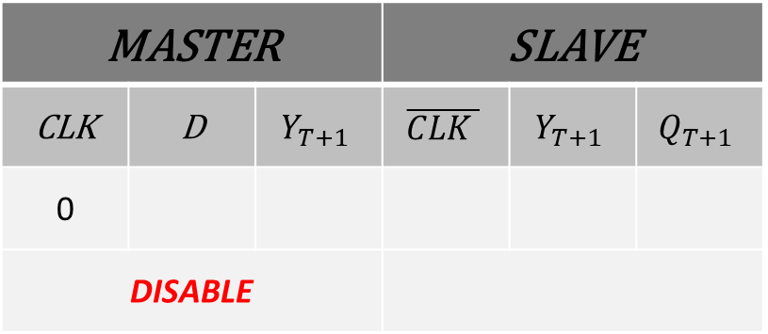
Master Slave FLIP-FLOP
MASTER |  |  | SLAVE
CLK | D | $$Y_{T+1}$$ | $$\overline{CLK }$$ | $$Y_{T+1}$$ | $$Q_{T+1}$$
0
DISABLE

Slide 20
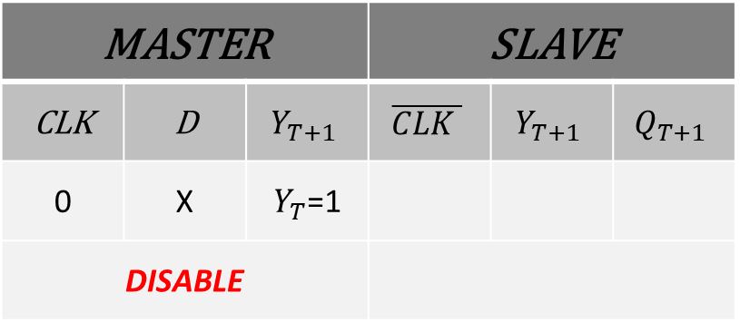
Master Slave FLIP-FLOP
MASTER |  |  | SLAVE
CLK | D | $$Y_{T+1}$$ | $$\overline{CLK }$$ | $$Y_{T+1}$$ | $$Q_{T+1}$$
0 | X | $Y_{T}$=1
DISABLE

Slide 21

Master Slave FLIP-FLOP
MASTER |  |  | SLAVE
CLK | D | $$Y_{T+1}$$ | $$\overline{CLK }$$ | $$Y_{T+1}$$ | $$Q_{T+1}$$
0 | X | $Y_{T}$=1 | 1
DISABLE

Slide 22
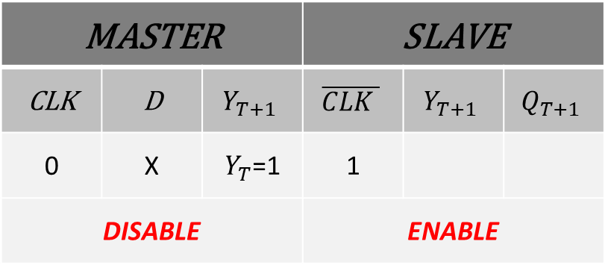
Master Slave FLIP-FLOP
MASTER |  |  | SLAVE
CLK | D | $$Y_{T+1}$$ | $$\overline{CLK }$$ | $$Y_{T+1}$$ | $$Q_{T+1}$$
0 | X | $Y_{T}$=1 | 1
DISABLE |  |  | ENABLE

Slide 23
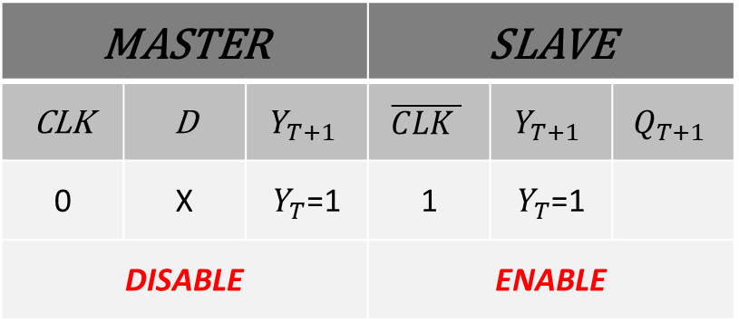
Master Slave FLIP-FLOP
MASTER |  |  | SLAVE
CLK | D | $$Y_{T+1}$$ | $$\overline{CLK }$$ | $$Y_{T+1}$$ | $$Q_{T+1}$$
0 | X | $Y_{T}$=1 | 1 | $Y_{T}$=1
DISABLE |  |  | ENABLE

Slide 24

Master Slave FLIP-FLOP
MASTER |  |  | SLAVE
CLK | D | $$Y_{T+1}$$ | $$\overline{CLK }$$ | $$Y_{T+1}$$ | $$Q_{T+1}$$
0 | X | $Y_{T}$=1 | 1 | $Y_{T}$=1 | 1
DISABLE |  |  | ENABLE

Slide 25
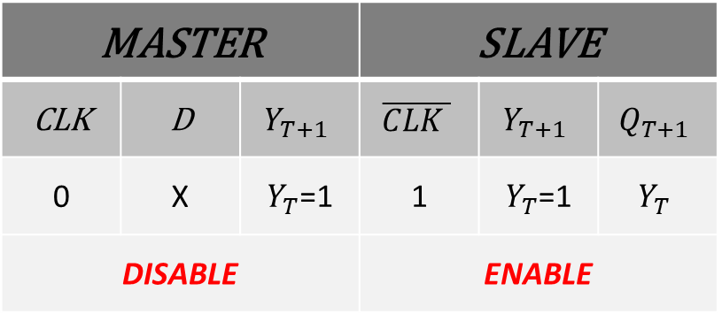
Master Slave FLIP-FLOP
MASTER |  |  | SLAVE
CLK | D | $$Y_{T+1}$$ | $$\overline{CLK }$$ | $$Y_{T+1}$$ | $$Q_{T+1}$$
0 | X | $Y_{T}$=1 | 1 | $Y_{T}$=1 | $$Y_{T}$$
DISABLE |  |  | ENABLE

Slide 26
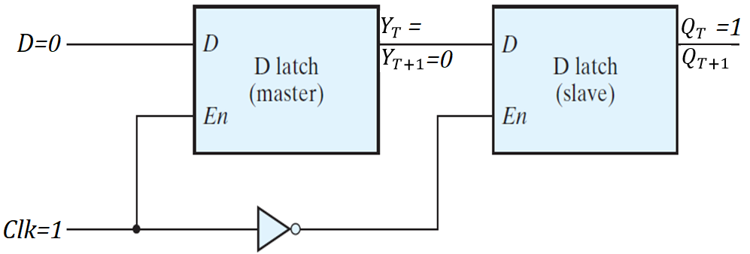
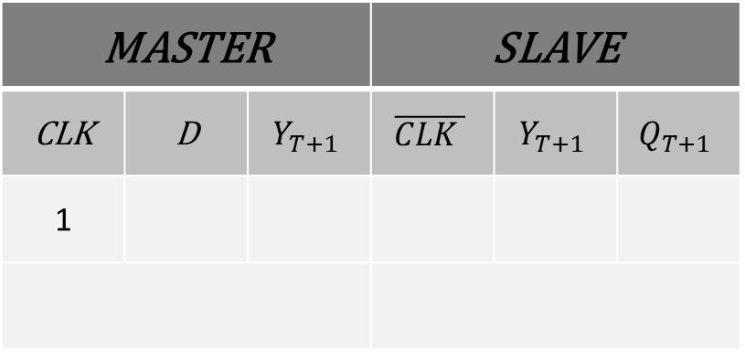
Master Slave FLIP-FLOP
MASTER |  |  | SLAVE
CLK | D | $$Y_{T+1}$$ | $$\overline{CLK }$$ | $$Y_{T+1}$$ | $$Q_{T+1}$$
1

Slide 27
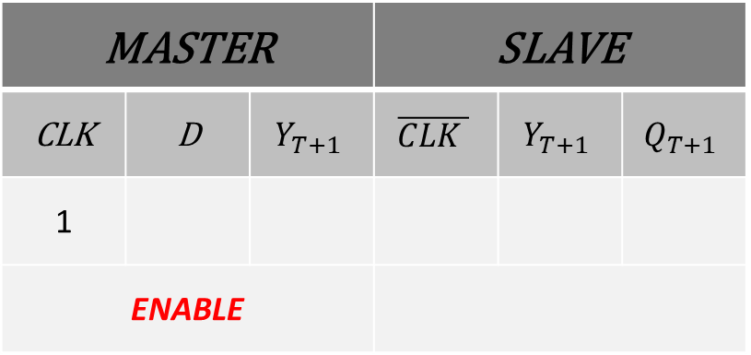
Master Slave FLIP-FLOP
MASTER |  |  | SLAVE
CLK | D | $$Y_{T+1}$$ | $$\overline{CLK }$$ | $$Y_{T+1}$$ | $$Q_{T+1}$$
1
ENABLE

Slide 28
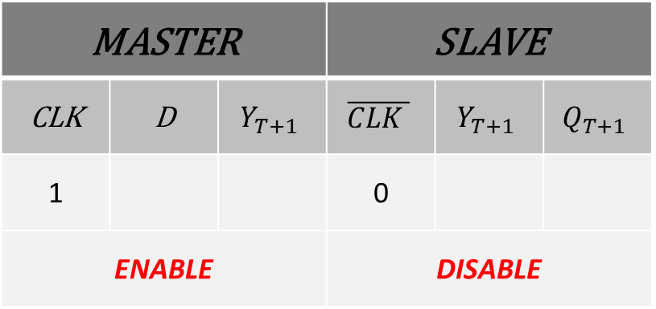
Master Slave FLIP-FLOP
MASTER |  |  | SLAVE
CLK | D | $$Y_{T+1}$$ | $$\overline{CLK }$$ | $$Y_{T+1}$$ | $$Q_{T+1}$$
1 |  |  | 0
ENABLE |  |  | DISABLE

Slide 29
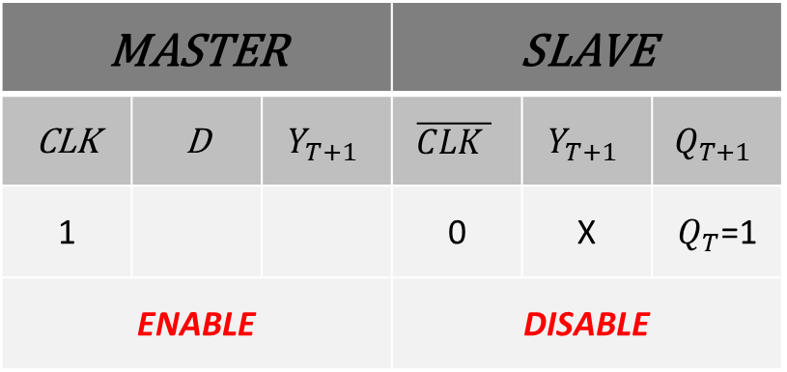
Master Slave FLIP-FLOP
MASTER |  |  | SLAVE
CLK | D | $$Y_{T+1}$$ | $$\overline{CLK }$$ | $$Y_{T+1}$$ | $$Q_{T+1}$$
1 |  |  | 0 | X | $Q_{T}$=1
ENABLE |  |  | DISABLE

Slide 30
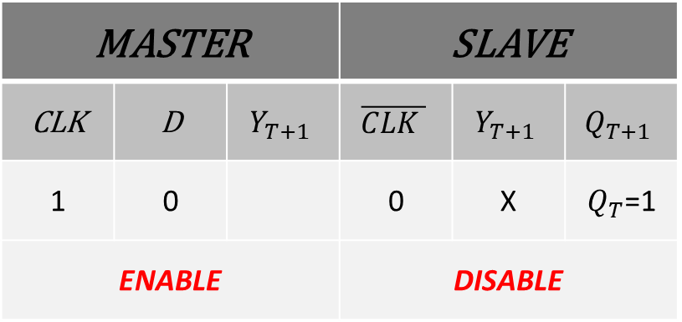
Master Slave FLIP-FLOP
MASTER |  |  | SLAVE
CLK | D | $$Y_{T+1}$$ | $$\overline{CLK }$$ | $$Y_{T+1}$$ | $$Q_{T+1}$$
1 | 0 |  | 0 | X | $Q_{T}$=1
ENABLE |  |  | DISABLE

Slide 31
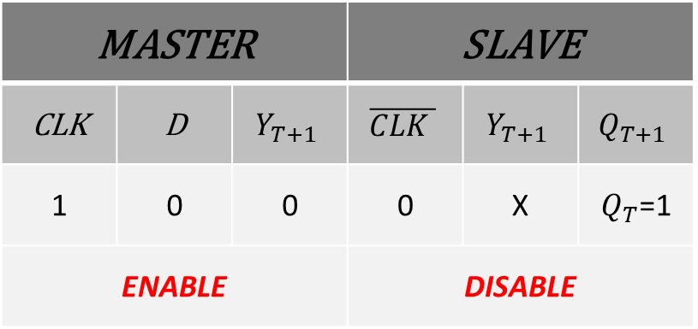
Master Slave FLIP-FLOP
MASTER |  |  | SLAVE
CLK | D | $$Y_{T+1}$$ | $$\overline{CLK }$$ | $$Y_{T+1}$$ | $$Q_{T+1}$$
1 | 0 | 0 | 0 | X | $Q_{T}$=1
ENABLE |  |  | DISABLE

Slide 32
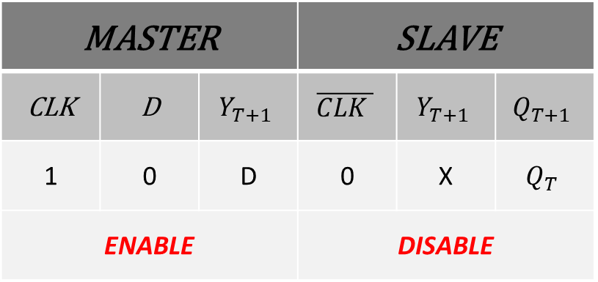
Master Slave FLIP-FLOP
MASTER |  |  | SLAVE
CLK | D | $$Y_{T+1}$$ | $$\overline{CLK }$$ | $$Y_{T+1}$$ | $$Q_{T+1}$$
1 | 0 | D | 0 | X | $$Q_{T}$$
ENABLE |  |  | DISABLE

Slide 33
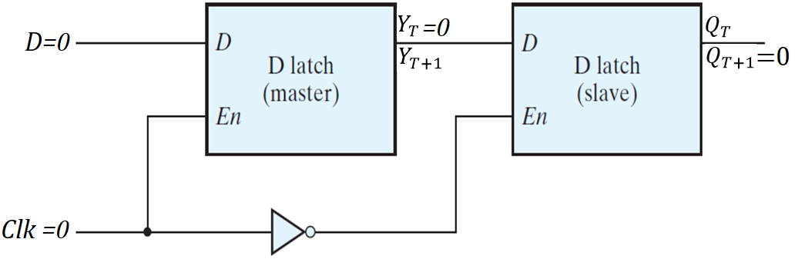
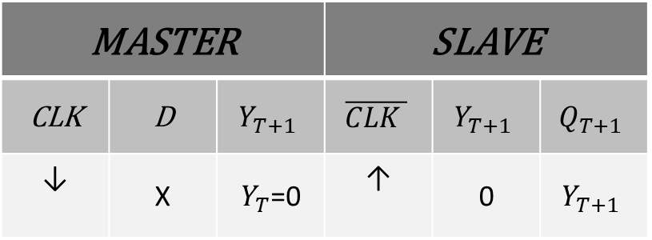
Master Slave FLIP-FLOP
MASTER |  |  | SLAVE
CLK | D | $$Y_{T+1}$$ | $$\overline{CLK }$$ | $$Y_{T+1}$$ | $$Q_{T+1}$$
↓ | X | $Y_{T}$=0 | ↑ | 0 | $$Y_{T+1}$$

Slide 34
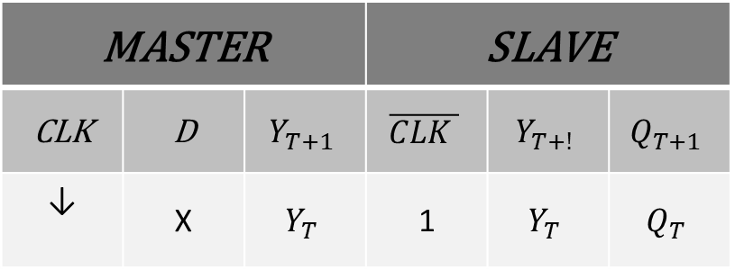
Master Slave FLIP-FLOP
MASTER |  |  | SLAVE
CLK | D | $$Y_{T+1}$$ | $$\overline{CLK }$$ | $$Y_{T+!}$$ | $$Q_{T+1}$$
↓ | X | $$Y_{T}$$ | 1 | $$Y_{T}$$ | $$Q_{T}$$

Slide 35
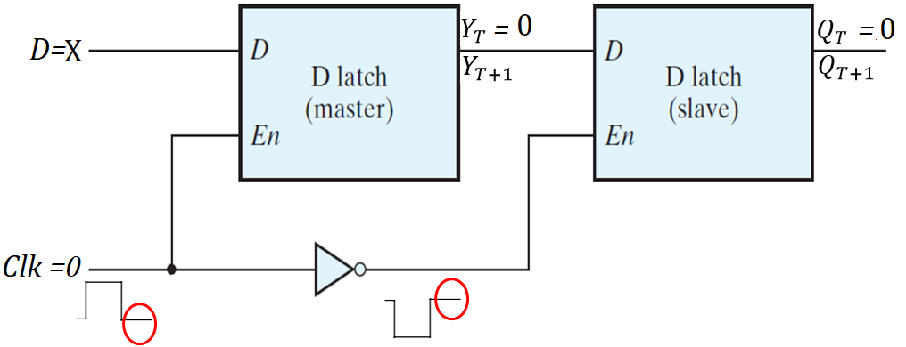
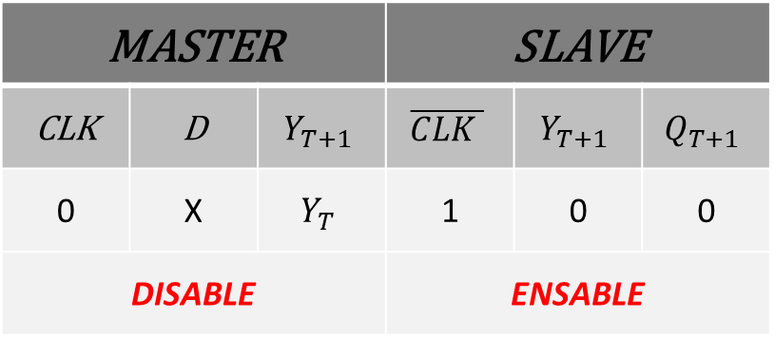
Master Slave FLIP-FLOP
MASTER |  |  | SLAVE
CLK | D | $$Y_{T+1}$$ | $$\overline{CLK }$$ | $$Y_{T+1}$$ | $$Q_{T+1}$$
0 | X | $$Y_{T}$$ | 1 | 0 | 0
DISABLE |  |  | ENSABLE

Slide 36
Master Slave FLIP-FLOP

Slide 37
D-FLIP-FLOP (NEGATIVE EDGE TRIGGERED)
Dynamic Input Indicator: FF only changes on Edge

Slide 38
JK-FLIP-FLOP
JK Flip-flop is similar to the SR Flip-flop with no INVALID CONDITION
*SR Flip-flop(SR GATED Latch with clock pulse on enable)
JK Flip Flop perform three operations
SET
RESET
COMPLEMENT

Slide 39
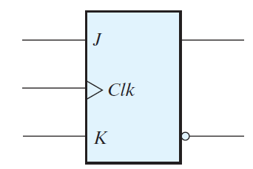
LOGIC SYMBOL (JK-FLIP-FLOP)

Slide 40
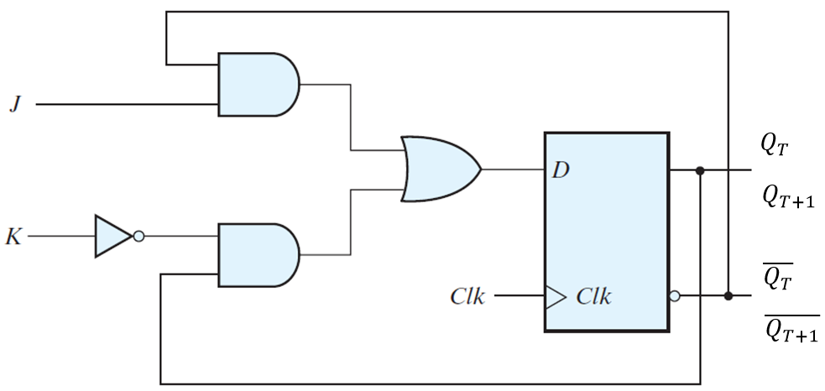
JK-FLIP-FLOP Using D-FLIP FLOP

Slide 41
CHARACTERISTIC EQUATION
$${Q_{T+1}=J\overline{Q_{T}}+\overline{K}Q}_{T}$$

Slide 42
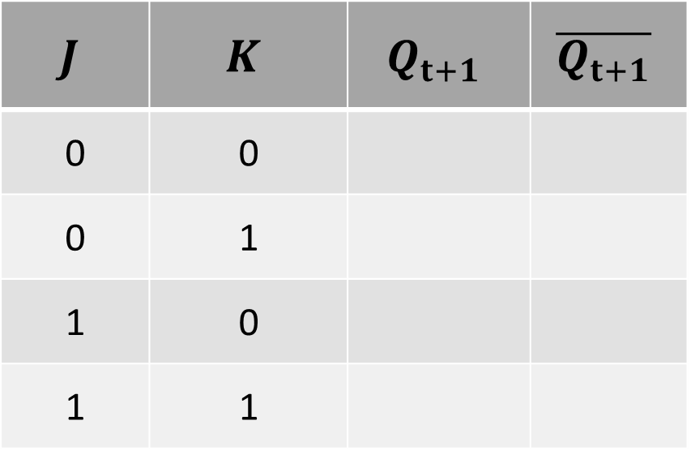
TRUTH TABLE (JK-FLIP-FLOP)
$$J$$ | $$K$$ | $$Q_{t+1}$$ | $$\overline{Q_{t+1}}$$
0 | 0
0 | 1
1 | 0
1 | 1

Slide 43
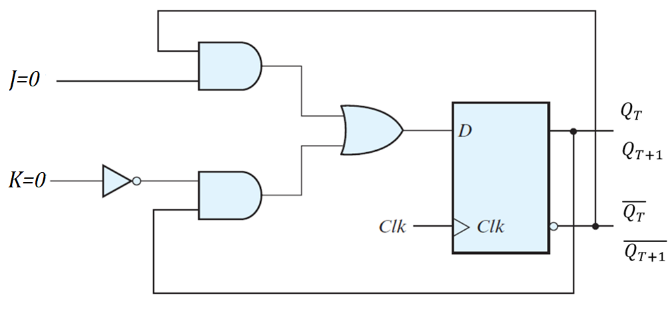
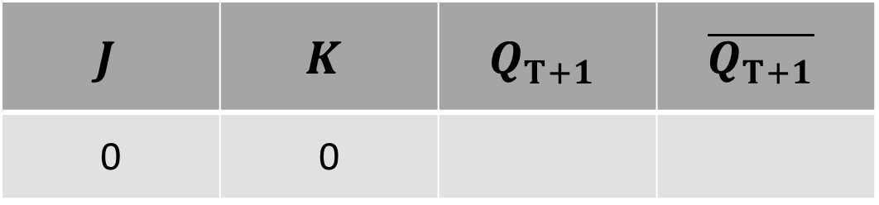
JK-FLIP-FLOP
$$J$$ | $$K$$ | $$Q_{T+1}$$ | $$\overline{Q_{T+1}}$$
0 | 0

Slide 44
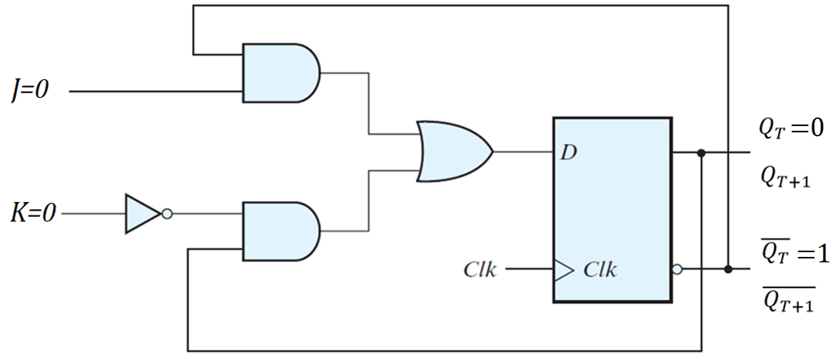
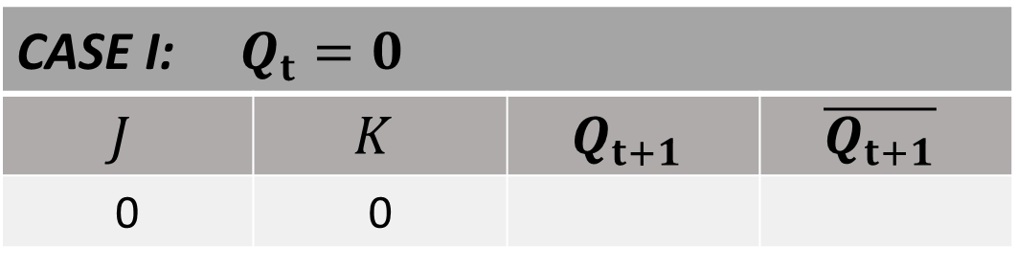
JK-FLIP-FLOP
CASE I: $Q_{t}=0$
$$J$$ | $$K$$ | $$Q_{t+1}$$ | $$\overline{Q_{t+1}}$$
0 | 0

Slide 45
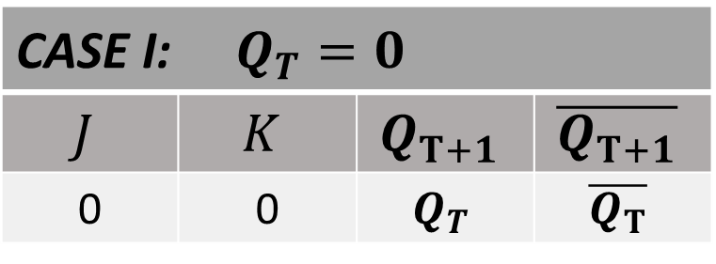
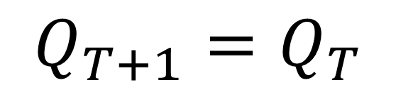
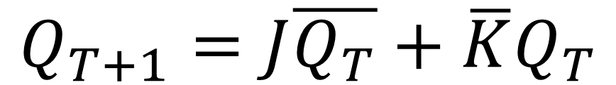
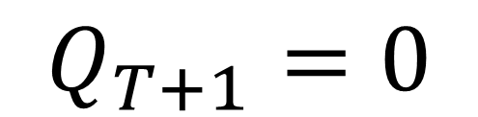
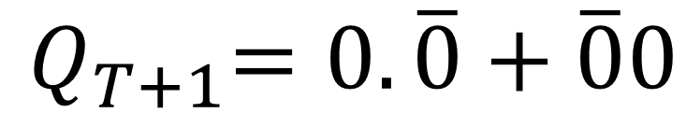
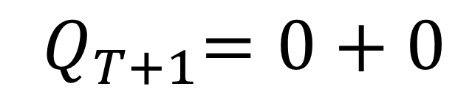
CHARACTERISTIC EQUATION
CASE I: $Q_{T}=0$
$$J$$ | $$K$$ | $$Q_{T+1}$$ | $$\overline{Q_{T+1}}$$
0 | 0 | $$Q_{T}$$ | $$\overline{Q_{T}}$$
$${Q_{T+1}=J\overline{Q_{T}}+\overline{K}Q}_{T}$$
$${ Q}_{T+1}=0.\overline{0}+\overline{0}0$$
$${ Q}_{T+1}=0+0$$
$$Q_{T+1}=0$$
$$Q_{T+1}=Q_{T}$$

Slide 46
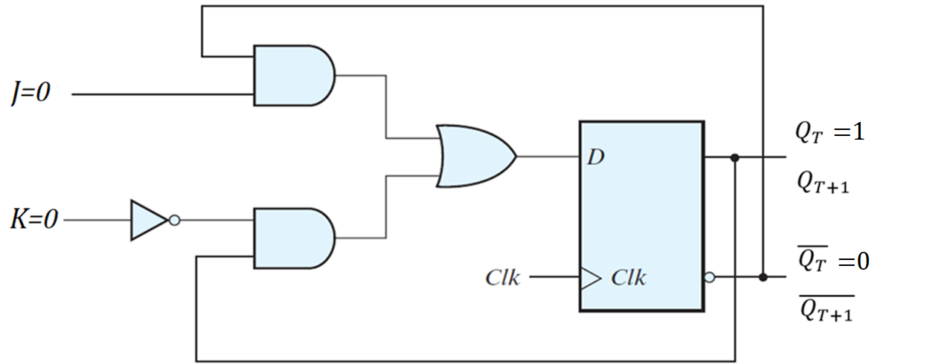
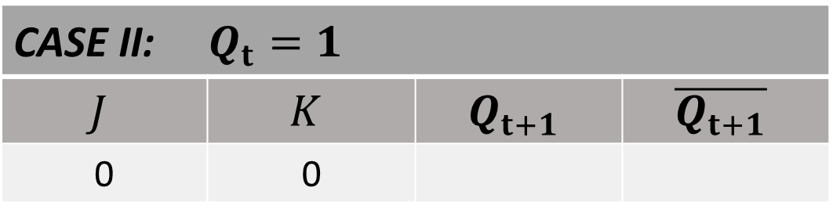
JK-FLIP-FLOP
CASE II: $Q_{t}=1$
$$J$$ | $$K$$ | $$Q_{t+1}$$ | $$\overline{Q_{t+1}}$$
0 | 0

Slide 47
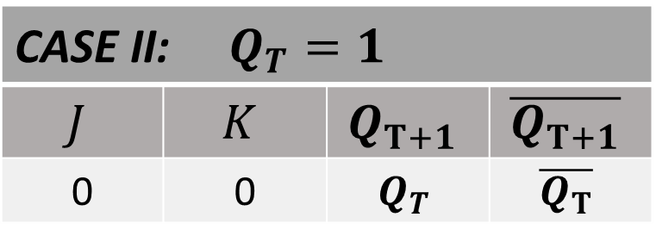
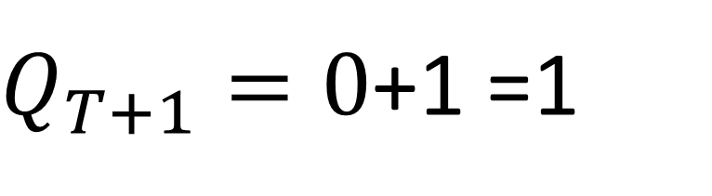
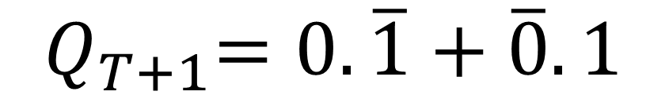
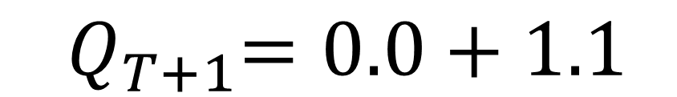
CHARACTERISTIC EQUATION
CASE II: $Q_{T}=1$
$$J$$ | $$K$$ | $$Q_{T+1}$$ | $$\overline{Q_{T+1}}$$
0 | 0 | $$Q_{T}$$ | $$\overline{Q_{T}}$$
$${Q_{T+1}=J\overline{Q_{T}}+\overline{K}Q}_{T}$$
$${ Q}_{T+1}=0.\overline{1}+\overline{0}.1$$
$${ Q}_{T+1}=0.0+1.1$$
$Q_{T+1}=0$+1 =1
$$Q_{T+1}=Q_{T}$$

Slide 48


COMPARING CASE I & II when J=0 , K=0
CASE I: $Q_{T}=0$
$$J$$ | $$K$$ | $$Q_{T+1}$$ | $$\overline{Q_{T+1}}$$
0 | 0 | $${0=Q}_{T}$$ | $$\overline{Q_{T}}$$
CASE II: $Q_{T}=1$
$$J$$ | $$K$$ | $$Q_{T+1}$$ | $$\overline{Q_{T+1}}$$
0 | 0 | 1=$Q_{T}$ | $$\overline{Q_{T}}$$

Slide 49

TRUTH TABLE
$$J$$ | $$K$$ | $$Q_{t+1}$$ | $$\overline{Q_{t+1}}$$
0 | 0 | $$Q_{T}$$ | $$\overline{Q_{T}}$$
0 | 1
1 | 0
1 | 1

Slide 50


JK-FLIP-FLOP
$$J$$ | $$K$$ | $$Q_{T+1}$$ | $$\overline{Q_{T+1}}$$
0 | 1

Slide 51


JK-FLIP-FLOP
CASE I: $Q_{t}=0$
$$J$$ | $$K$$ | $$Q_{t+1}$$ | $$\overline{Q_{t+1}}$$
0 | 1

Slide 52





CHARACTERISTIC EQUATION
CASE I: $Q_{T}=0$
$$J$$ | $$K$$ | $$Q_{T+1}$$ | $$\overline{Q_{T+1}}$$
0 | 1 | 0 | 1
$${Q_{T+1}=J\overline{Q_{T}}+\overline{K}Q}_{T}$$
$${ Q}_{T+1}=0.\overline{0}+\overline{1}0$$
$${ Q}_{T+1}=0.1+0.0$$
$$Q_{T+1}=0+0$$
$$Q_{T+1}=0$$

Slide 53


JK-FLIP-FLOP
CASE II: $Q_{t}=1$
$$J$$ | $$K$$ | $$Q_{t+1}$$ | $$\overline{Q_{t+1}}$$
0 | 1

Slide 54





CHARACTERISTIC EQUATION
CASE II: $Q_{T}=1$
$$J$$ | $$K$$ | $$Q_{T+1}$$ | $$\overline{Q_{T+1}}$$
0 | 1 | 0 | 1
$${Q_{T+1}=J\overline{Q_{T}}+\overline{K}Q}_{T}$$
$${ Q}_{T+1}=0.\overline{1}+\overline{1}.1$$
$${ Q}_{T+1}=0.0+0.1$$
$Q_{T+1}=0+$0
$$Q_{T+1}=O$$

Slide 55


COMPARING CASE I & II when J=0 , K=1
CASE I: $Q_{T}=0$
$$J$$ | $$K$$ | $$Q_{T+1}$$ | $$\overline{Q_{T+1}}$$
0 | 1 | 0 | 1
CASE II: $Q_{T}=1$
$$J$$ | $$K$$ | $$Q_{T+1}$$ | $$\overline{Q_{T+1}}$$
0 | 1 | 0 | 1

Slide 56

TRUTH TABLE
$$J$$ | $$K$$ | $$Q_{t+1}$$ | $$\overline{Q_{t+1}}$$
0 | 0 | $$Q_{T}$$ | $$\overline{Q_{T}}$$
0 | 1 | 0 | 1
1 | 0
1 | 1

Slide 57


JK-FLIP-FLOP
$$J$$ | $$K$$ | $$Q_{T+1}$$ | $$\overline{Q_{T+1}}$$
1 | 0

Slide 58


JK-FLIP-FLOP
CASE I: $Q_{t}=0$
$$J$$ | $$K$$ | $$Q_{t+1}$$ | $$\overline{Q_{t+1}}$$
1 | 0

Slide 59





CHARACTERISTIC EQUATION
CASE I: $Q_{T}=0$
$$J$$ | $$K$$ | $$Q_{T+1}$$ | $$\overline{Q_{T+1}}$$
1 | 0 | $$1$$ | $$0$$
$${Q_{T+1}=J\overline{Q_{T}}+\overline{K}Q}_{T}$$
$${ Q}_{T+1}=1.\overline{0}+\overline{0}0$$
$${ Q}_{T+1}=1.1+1.0$$
$$Q_{T+1}=1+0$$
$$Q_{T+1}=1$$

Slide 60


JK-FLIP-FLOP
CASE II: $Q_{t}=1$
$$J$$ | $$K$$ | $$Q_{t+1}$$ | $$\overline{Q_{t+1}}$$
1 | 0

Slide 61





CHARACTERISTIC EQUATION
CASE II: $Q_{T}=1$
$$J$$ | $$K$$ | $$Q_{T+1}$$ | $$\overline{Q_{T+1}}$$
1 | 0 | $$1$$ | $$0$$
$${Q_{T+1}=J\overline{Q_{T}}+\overline{K}Q}_{T}$$
$${ Q}_{T+1}=1.\overline{1}+\overline{0}.1$$
$${ Q}_{T+1}=1.0+1.1$$
$Q_{T+1}=0$+1
$$Q_{T+1}=1$$

Slide 62


COMPARING CASE I & II when J=1 , K=0
CASE I: $Q_{T}=0$
$$J$$ | $$K$$ | $$Q_{T+1}$$ | $$\overline{Q_{T+1}}$$
1 | 0 | $$1$$ | $$0$$
CASE II: $Q_{T}=1$
$$J$$ | $$K$$ | $$Q_{T+1}$$ | $$\overline{Q_{T+1}}$$
1 | 0 | $$1$$ | $$0$$

Slide 63

TRUTH TABLE
$$J$$ | $$K$$ | $$Q_{t+1}$$ | $$\overline{Q_{t+1}}$$
0 | 0 | $$Q_{T}$$ | $$\overline{Q_{T}}$$
0 | 1 | 0 | 1
1 | 0 | 1 | 0
1 | 1

Slide 64


JK-FLIP-FLOP
$$J$$ | $$K$$ | $$Q_{T+1}$$ | $$\overline{Q_{T+1}}$$
1 | 1

Slide 65


JK-FLIP-FLOP
CASE I: $Q_{t}=0$
$$J$$ | $$K$$ | $$Q_{t+1}$$ | $$\overline{Q_{t+1}}$$
1 | 1

Slide 66





CHARACTERISTIC EQUATION
CASE I: $Q_{T}=0$
$$J$$ | $$K$$ | $$Q_{T+1}$$ | $$\overline{Q_{T+1}}$$
1 | 1 | $$\overline{Q_{T}}$$ | $$Q_{T}$$
$${Q_{T+1}=J\overline{Q_{T}}+\overline{K}Q}_{T}$$
$${ Q}_{T+1}=1.\overline{0}+\overline{1}0$$
$${ Q}_{T+1}=1.1+0.0$$
$Q_{T+1}=1+0$ = 1
$$Q_{T+1}=\overline{Q_{T}}$$

Slide 67


JK-FLIP-FLOP
CASE II: $Q_{t}=1$
$$J$$ | $$K$$ | $$Q_{t+1}$$ | $$\overline{Q_{t+1}}$$
1 | 1

Slide 68





CHARACTERISTIC EQUATION
CASE II: $Q_{T}=1$
$$J$$ | $$K$$ | $$Q_{T+1}$$ | $$\overline{Q_{T+1}}$$
1 | 1 | $$\overline{Q_{T}}$$ | $$Q_{T}$$
$${Q_{T+1}=J\overline{Q_{T}}+\overline{K}Q}_{T}$$
$${ Q}_{T+1}=1.\overline{1}+\overline{1}.1$$
$${ Q}_{T+1}=1.0+0.1$$
$Q_{T+1}=0+0=0$
$$Q_{T+1}=\overline{Q_{T}}$$

Slide 69


COMPARING CASE I & II when J=1 , K=1
CASE I: $Q_{T}=0$
$$J$$ | $$K$$ | $$Q_{T+1}$$ | $$\overline{Q_{T+1}}$$
1 | 1 | 1 = $\overline{Q_{T}}$ | $$Q_{T}$$
CASE II: $Q_{T}=1$
$$J$$ | $$K$$ | $$Q_{T+1}$$ | $$\overline{Q_{T+1}}$$
1 | 1 | 0 = $\overline{Q_{T}}$ | $$Q_{T}$$

Slide 70

TRUTH TABLE
$$J$$ | $$K$$ | $$Q_{t+1}$$ | $$\overline{Q_{t+1}}$$
0 | 0 | $$Q_{T}$$ | $$\overline{Q_{T}}$$
0 | 1 | 0 | 1
1 | 0 | 1 | 0
1 | 1 | $$\overline{Q_{T}}$$ | $$Q_{T}$$

Slide 71

CHARACTERISTIC TABLE
$$J$$ | $$K$$ | $$Q_{t+1}$$ | $$\overline{Q_{t+1}}$$ | COMMENT
0 | 0 | $$Q_{T}$$ | $$\overline{Q_{T}}$$ | NO CHANGE
0 | 1 | 0 | 1 | RESET
1 | 0 | 1 | 0 | SET
1 | 1 | $$\overline{Q_{T}}$$ | $$Q_{T}$$ | TOGGLE/ COMPLEMENT

Slide 72

CHARACTERISTIC TABLE
$$J$$ | $$K$$ | $$Q_{t+1}$$ | COMMENT
0 | 0 | $$Q_{T}$$ | NO CHANGE
0 | 1 | 0 | RESET
1 | 0 | 1 | SET
1 | 1 | $$\overline{Q_{T}}$$ | TOGGLE/ COMPLEMENT

Slide 73

CHARACTERISTIC TABLE
$$J$$ | $$K$$ | $$Q_{t+1}$$
0 | 0 | $$Q_{T}$$
0 | 1 | 0
1 | 0 | 1
1 | 1 | $$\overline{Q_{T}}$$

Slide 74
T-FLIP FLOP
The T or "toggle" flip-flop
T input is low, the flip-flop holds the previous value.
T input is high, the T flip-flop changes toggles old state ("toggles") whenever the clock input is strobed.
Used in binary counters, frequency dividers, and general binary addition devices.

Slide 75

LOGIC SYMBOL (T-FLIP-FLOP)

Slide 76

T-FLIP-FLOP Using D-FLIP FLOP

Slide 77


CHARACTERISTIC EQUATION
$${Q_{T+1}=T+Q}_{T}$$
$${Q_{T+1}=T\overline{Q_{T}}+\overline{T}Q}_{T}$$

Slide 78

TRUTH TABLE (T-FLIP-FLOP)
$$T$$ | $$Q_{T+1}$$ | $$\overline{Q_{T+1}}$$
0
1

Slide 79


T-FLIP-FLOP
$$T$$ | $$Q_{T+1}$$ | $$\overline{Q_{T+1}}$$
0

Slide 80


T-FLIP-FLOP
CASE I: $Q_{T}=0$
$$T$$ | $$Q_{T+1}$$ | $$\overline{Q_{T+1}}$$
0

Slide 81





CHARACTERISTIC EQUATION
CASE I: $Q_{T}=0$
$$T$$ | $$Q_{T+1}$$ | $$\overline{Q_{T+1}}$$
0 | 0 | 1
$${Q_{T+1}=T\overline{Q_{T}}+\overline{T}Q}_{T}$$
$$Q_{T+1}=0.\overline{0}+\overline{0}.0$$
$$Q_{T+1}=0.1+1.0$$
$Q_{T+1}=0+0$ = 0

Slide 82


T-FLIP-FLOP
CASE II: $Q_{T}=1$
$$T$$ | $$Q_{T+1}$$ | $$\overline{Q_{T+1}}$$
0

Slide 83




CHARACTERISTIC EQUATION
CASE II: $Q_{T}=1$
$$T$$ | $$Q_{T+1}$$ | $$\overline{Q_{T+1}}$$
0 | 1 | 0
$${Q_{T+1}=T\overline{Q_{T}}+\overline{T}Q}_{T}$$
$$Q_{T+1}=0.\overline{1}+\overline{0}.1$$
$$Q_{T+1}=0.0+1.1$$
$Q_{T+1}=0+1$ = 1

Slide 84


COMPARING CASE I & II when T=0
CASE I: $Q_{T}=0$
$$T$$ | $$Q_{T+1}$$ | $$\overline{Q_{T+1}}$$
0 | 0 =$Q_{T}$ | 1= $\overline{Q_{T}}$
CASE II: $Q_{T}=1$
$$T$$ | $$Q_{T+1}$$ | $$\overline{Q_{T+1}}$$
0 | 1=$Q_{T}$ | 0 = $\overline{Q_{T}}$

Slide 85

TRUTH TABLE (T-FLIP-FLOP)
$$T$$ | $$Q_{t+1}$$ | $$\overline{Q_{t+1}}$$
0 | $$Q_{t}$$ | $$\overline{Q_{t}}$$
1

Slide 86


T-FLIP-FLOP
$$T$$ | $$Q_{T+1}$$ | $$\overline{Q_{T+1}}$$
1

Slide 87


T-FLIP-FLOP
CASE I: $Q_{T}=0$
$$T$$ | $$Q_{T+1}$$ | $$\overline{Q_{T+1}}$$
1

Slide 88




CHARACTERISTIC EQUATION
CASE I: $Q_{T}=0$
$$T$$ | $$Q_{T+1}$$ | $$\overline{Q_{T+1}}$$
1 | 1 | 0
$${Q_{T+1}=T\overline{Q_{T}}+\overline{T}Q}_{T}$$
$$Q_{T+1}=1.\overline{0}+\overline{1}.0$$
$$Q_{T+1}=1.1+0.0$$
$Q_{T+1}=1+0$ = 1

Slide 89


T-FLIP-FLOP
CASE II: $Q_{T}=1$
$$T$$ | $$Q_{T+1}$$ | $$\overline{Q_{T+1}}$$
1

Slide 90




CHARACTERISTIC EQUATION
CASE II: $Q_{T}=1$
$$T$$ | $$Q_{T+1}$$ | $$\overline{Q_{T+1}}$$
1 | 0 | 1
$${Q_{T+1}=T\overline{Q_{T}}+\overline{T}Q}_{T}$$
$$Q_{T+1}=1.\overline{1}+\overline{1}.1$$
$$Q_{T+1}=1.0+0.1$$
$Q_{T+1}=0+0$ = 0

Slide 91


COMPARING CASE I & II when T=1
CASE I: $Q_{T}=0$
$$T$$ | $$Q_{T+1}$$ | $$\overline{Q_{T+1}}$$
1 | 1= $\overline{Q_{T}}$ | 0 =$Q_{T}$
CASE II: $Q_{T}=1$
$$T$$ | $$Q_{T+1}$$ | $$\overline{Q_{T+1}}$$
1 | 0 = $\overline{Q_{T}}$ | 1=$Q_{T}$

Slide 92

TRUTH TABLE (T-FLIP-FLOP)
$$T$$ | $$Q_{t+1}$$ | $$\overline{Q_{t+1}}$$
0 | $$Q_{t}$$ | $$\overline{Q_{t}}$$
1 | $$\overline{Q_{t}}$$ | $$Q_{t}$$

Slide 93

TRUTH TABLE (T-FLIP-FLOP)
$$T$$ | $$Q_{t+1}$$ | $$\overline{Q_{t+1}}$$ | COMMENT
0 | $$Q_{t}$$ | $$\overline{Q_{t}}$$ | NO CHANGE
1 | $$\overline{Q_{t}}$$ | $$Q_{t}$$ | TOGGLE

Slide 94
Flip Flop
D-Type Positive Edge Triggered

Slide 95
Master Slave D-FLIP-FLOP(NEGATIVE EDGE TRIGGERED)

Slide 96

D-FLIP-FLOP (POSITIVE EDGE TRIGGERED)

Slide 97

D-FLIP-FLOP (POSITIVE EDGE TRIGGERED)

Slide 98
D-FLIP-FLOP (POSITIVE EDGE TRIGGERED)
Three SR LATCH

Slide 99
D-FLIP-FLOP (POSITIVE EDGE TRIGGERED)
Three SR LATCH
TOP
OUTPUT
BOTTOM

Slide 100

SR LATCH TABLE
$$\overline{\text{S} }$$ | $$\overline{\text{R} }$$ | $$Q_{t+1}$$ | $$\overline{Q_{t+1}}$$ | COMMENT
0 | 0 | 1 | 1 | INVALID CONDITION
0 | 1 | 1 | 0 | SET
1 | 0 | 0 | 1 | RESET
1 | 1 | $$Q_{t}$$ | $$\overline{Q_{t}}$$ | NO CHANGE

Slide 101

SR LATCH TABLE
$$\overline{\text{S} }$$ | $$\overline{\text{R} }$$ | $$Q_{t+1}$$ | COMMENT
0 | 0 | RC | INVALID CONDITION
0 | 1 | 1 | SET
1 | 0 | 0 | RESET
1 | 1 | $$Q_{t}$$ | NO CHANGE

Slide 102


D-FLIP-FLOP (POSITIVE EDGE TRIGGERED)
Clk | D | $$Q_{T+1}$$
0

Slide 103

D-FLIP-FLOP (POSITIVE EDGE TRIGGERED)
Clk | D | $$Q_{T+1}$$
0

Slide 104

TRUTH TABLE
$$Clk$$ | $$D$$ | $$Q_{t+1}$$ | $$\overline{Q_{t+1}}$$
0 | X | $$Q_{T}$$ | $$\overline{Q_{T}}$$
1 | X
 | 0
 | 1

Slide 105
TRUTH TABLE
$$Clk$$ | $$D$$ | $$Q_{t+1}$$ | $$\overline{Q_{t+1}}$$
0 | X | $$Q_{T}$$ | $$\overline{Q_{T}}$$
1 | X
 | 0
 | 1

Slide 106


D-FLIP-FLOP (POSITIVE EDGE TRIGGERED)
D | Clk | $$Q_{T+1}$$
0

Slide 107

TRUTH TABLE
$$Clk$$ | $$D$$ | $$Q_{t+1}$$ | $$\overline{Q_{t+1}}$$
0 | X | $$Q_{T}$$ | $$\overline{Q_{T}}$$
1
 | 0 | 0 | 1

Slide 108


D-FLIP-FLOP (POSITIVE EDGE TRIGGERED)
Clk | D | $$Q_{T+1}$$
1

Slide 109

TRUTH TABLE
$$Clk$$ | $$D$$ | $$Q_{t+1}$$ | $$\overline{Q_{t+1}}$$
0 | X | $$Q_{T}$$ | $$\overline{Q_{T}}$$
1 | X | $$Q_{T}$$ | $$\overline{Q_{T}}$$
 | 0 | 0 | 1
 | 1

Slide 110

D-FLIP-FLOP (POSITIVE EDGE TRIGGERED)
Clk | D | $$Q_{T+1}$$
0

Slide 111

TRUTH TABLE
$$Clk$$ | $$D$$ | $$Q_{t+1}$$ | $$\overline{Q_{t+1}}$$
0 | X | $$Q_{T}$$ | $$\overline{Q_{T}}$$
1 | X
 | 0 | 0 | 1
 | 1

Slide 112


D-FLIP-FLOP (POSITIVE EDGE TRIGGERED)
D | Clk | $$Q_{T+1}$$
1

Slide 113

TRUTH TABLE
$$Clk$$ | $$D$$ | $$Q_{t+1}$$ | $$\overline{Q_{t+1}}$$
0 | X | $$Q_{T}$$ | $$\overline{Q_{T}}$$
1 | X | $$Q_{T}$$ | $$\overline{Q_{T}}$$
 | 0 | 0 | 1
 | 1 | 1 | 0

Slide 114

D-FLIP-FLOP (POSITIVE EDGE TRIGGERED)
Clk | D | $$Q_{T+1}$$
1

Slide 115

TRUTH TABLE
$$Clk$$ | $$D$$ | $$Q_{t+1}$$ | $$\overline{Q_{t+1}}$$
0 | X | $$Q_{T}$$ | $$\overline{Q_{T}}$$
1 | X | $$Q_{T}$$ | $$\overline{Q_{T}}$$
 | 0 | 0 | 1
 | 1 | 1 | 0

Slide 116

TRUTH TABLE
$$Clk$$ | $$D$$ | $$Q_{t+1}$$ | $$\overline{Q_{t+1}}$$ | COMMENT
0 | X | $$Q_{T}$$ | $$\overline{Q_{T}}$$ | NO CHANGE
1 | X | $$Q_{T}$$ | $$\overline{Q_{T}}$$ | NO CHANGE
 | 0 | 0 | 1 | RESET
 | 1 | 1 | 0 | SET

Slide 117
D-FLIP FLOP with ASYNCHRONOUS RESET

Slide 118
D-FLIP-FLOP (POSITIVE EDGE TRIGGERED)

Slide 119

BLOCK DIAGRAM (D-FLIP FLOP with DIRECT INPUT)

Slide 120
D-FLIP FLOP with DIRECT INPUT
Force Flip Flop to Particular state independently of the CLOCK
PRESET/ DIRECT SET: Set Flip-Flop to 1
CLEAR/ DIRECT RESET: Clears Flip-Flop to 0
Usage: Digital systems are Cleared/PRESET before CLOCKED OPERATION

Slide 121

D-FLIP FLOP AYSNCHRONOUS RESET

Slide 122

D-FLIP FLOP AYSNCHRONOUS RESET

Slide 123

FUNCTION TABLE (D FLIPFLOP with DIRECT INPUTS)
$$R$$ | $$Clk$$ | $$D$$ | $$Q_{T+1}$$ | $$\overline{Q_{T+1}}$$
1 |  | 0 | 0 | 1
1 |  | 1 | 1 | 0

Slide 124

D-FLIP FLOP AYSNCHRONOUS RESET

Slide 125

TABLE (D FLIPFLOP with DIRECT INPUTS
$$R$$ | $$Clk$$ | $$D$$ | $$Q_{T+1}$$ | $$\overline{Q_{T+1}}$$
0 | X | X | $$0$$ | $$1$$
1 |  | 0 | 0 | 1
1 |  | 1 | 1 | 0

Slide 126

TABLE (D FLIPFLOP with DIRECT INPUTS
$$R$$ | $$Clk$$ | $$D$$ | $$Q_{T+1}$$ | COMMENT
0 | X | X | 0 | Asynchronous Reset
1 |  | 0 | 0 | Clocked Reset
1 |  | 1 | 1 | Clocked Set

